Slide 1


Parent, Community & Student Services Division of Instruction
Parent, Community & Student Services Certification

Slide 2
OBJECTIVES
1. Parent Community Student Services
Certification
2. Parent Community Student Services
Certification Resources
3. School Report Card Resources
4. School Experience Survey Action Plan

Slide 3
Parent Community Student Services Certification

Slide 4
Overview
LAUSD is committed to engaging parents in their child’s education. Over 30 years of research confirms the important role of parent involvement in student achievement. Parents are their child’s first and life-long teachers who influence their child’s educational outcomes in powerful and long-lasting ways. The core belief that parents are our partners to support academic achievement is the foundation for the District’s overarching policy on parent involvement.

Slide 5
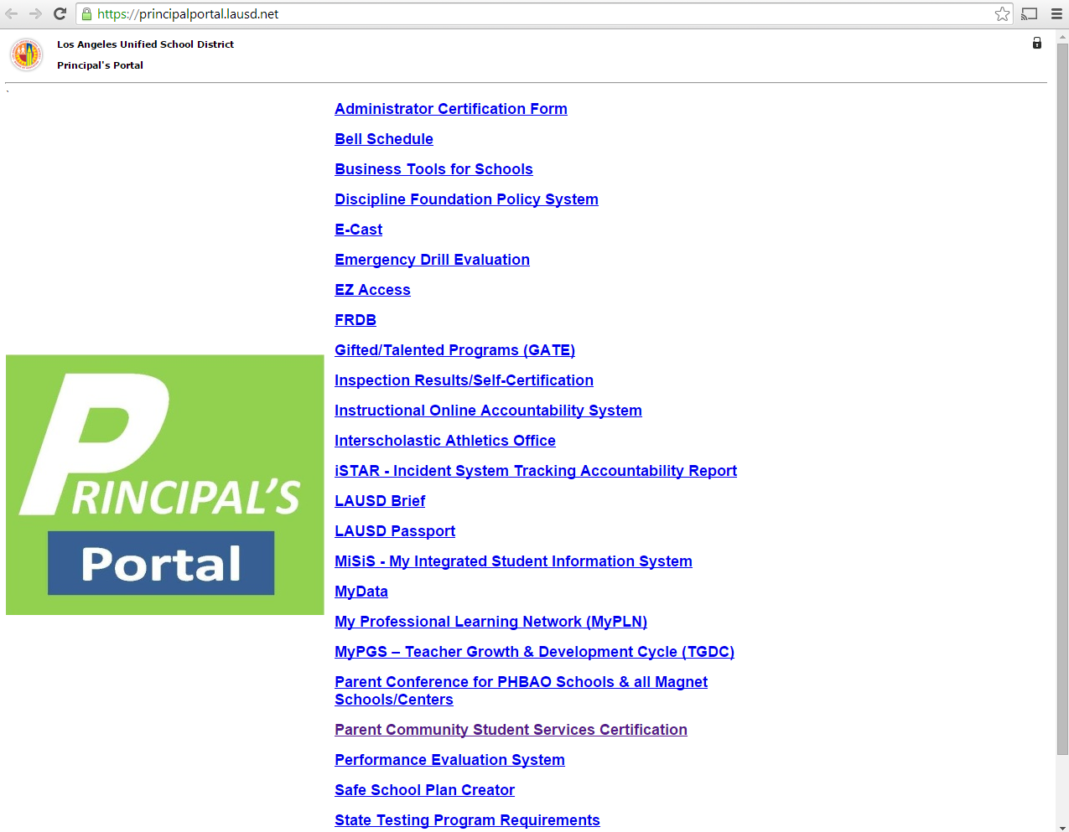

Slide 7
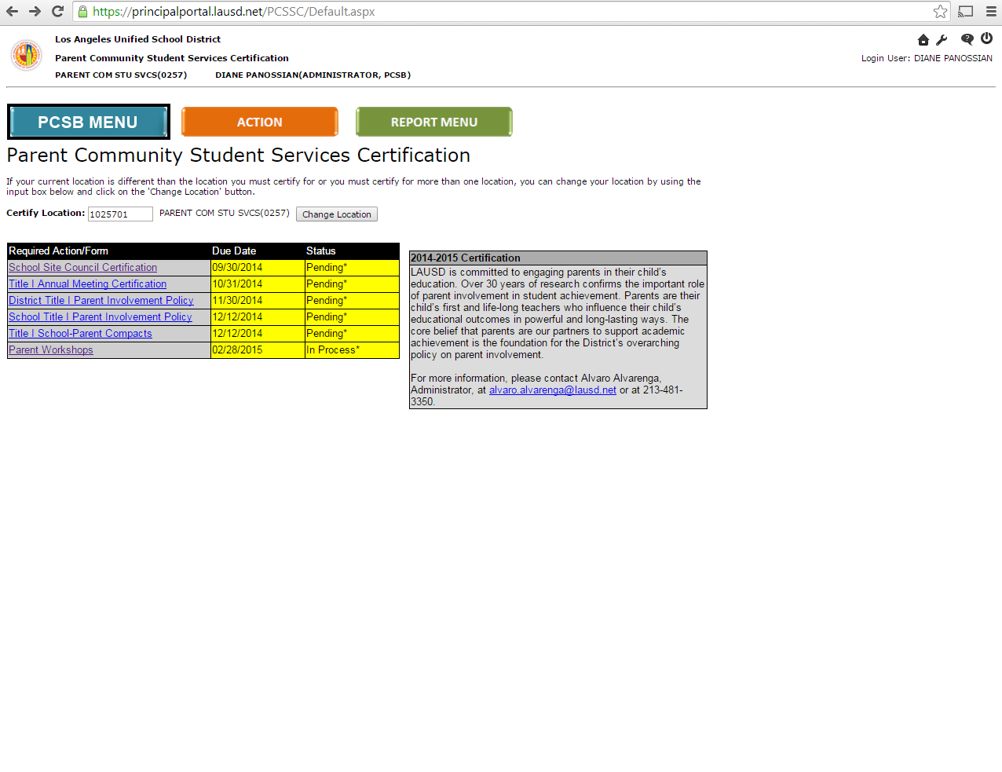

Slide 20
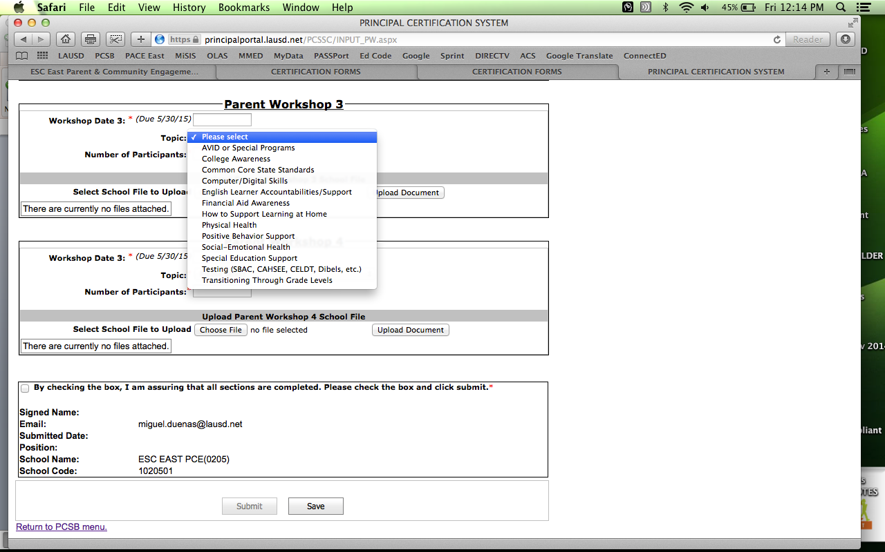
Workshop 3 & 4 Topics

Slide 22
Parent Community Student Services Certification
Resources

Slide 23
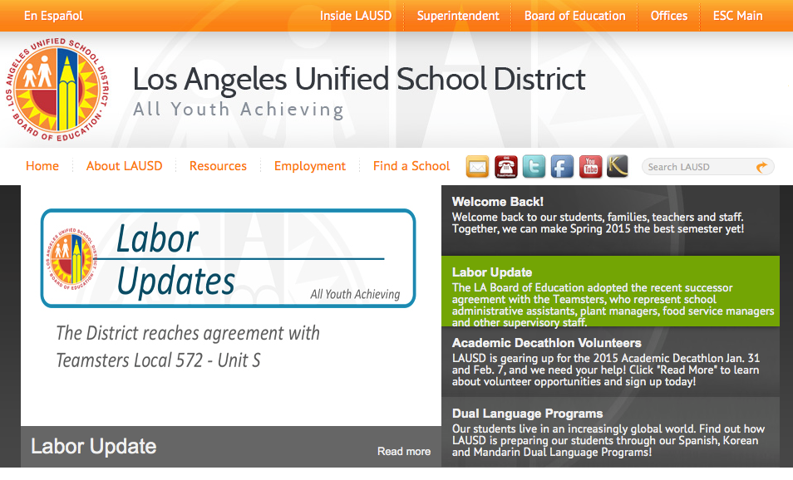

Slide 24
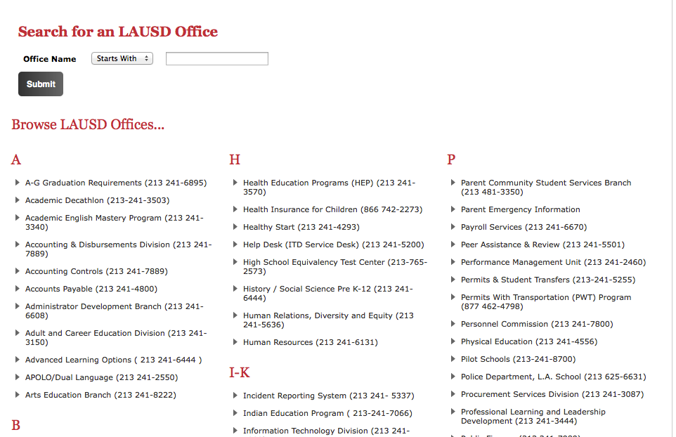

Slide 25
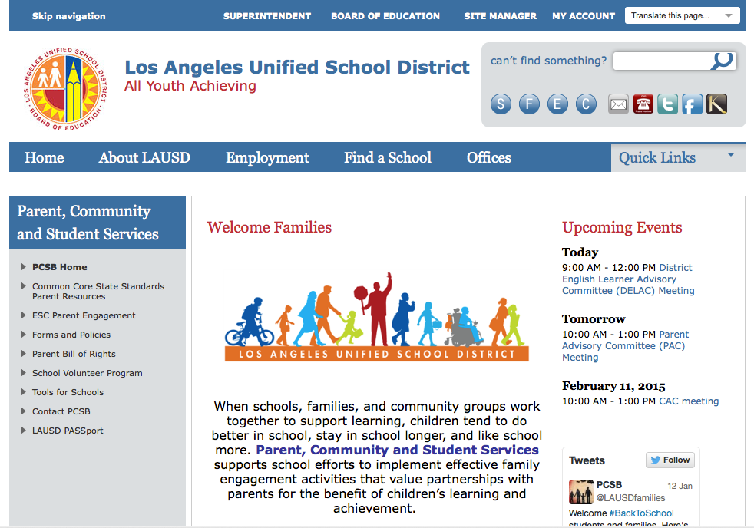

Slide 26
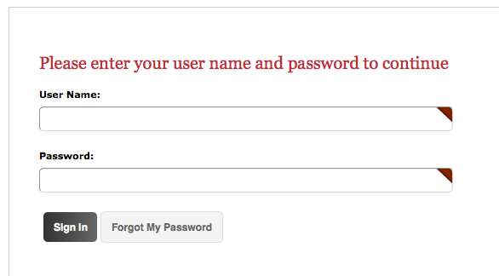

Slide 27
Required Parents Trainings Resources

Slide 28
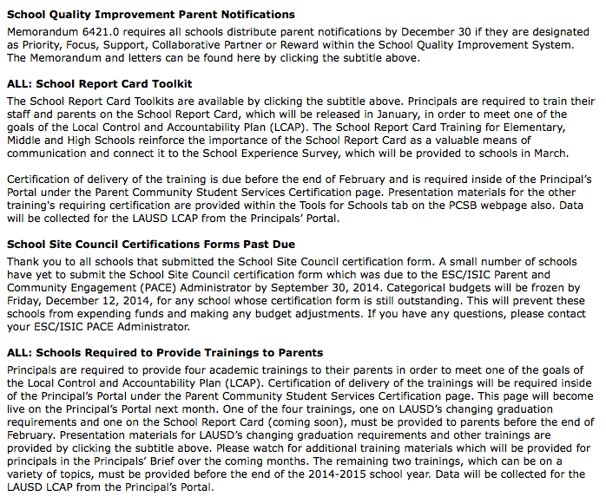

Slide 29
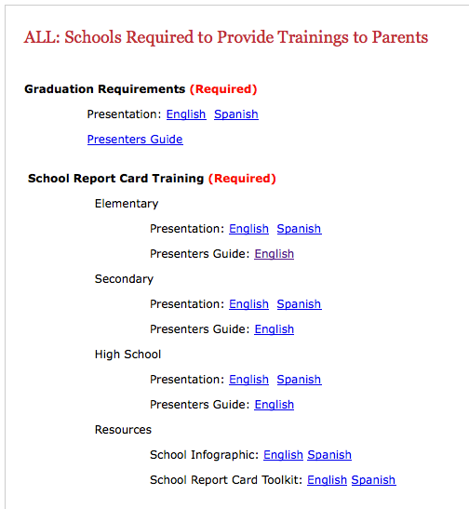

Slide 30
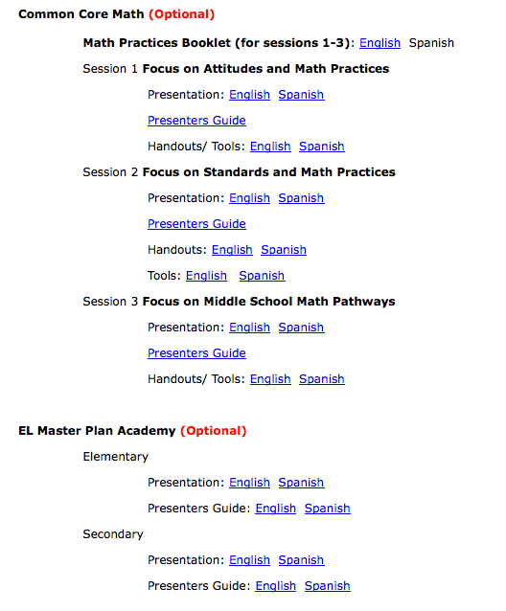

Slide 31
School Report Card Tool Kit Resources

Slide 33
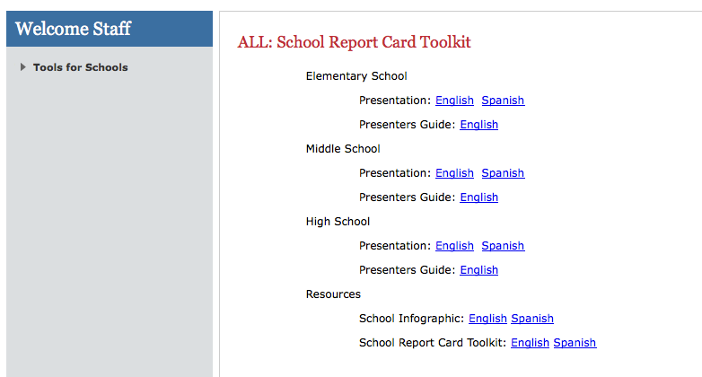

Slide 34


The School Experience Survey (SES) results are reported on the School Report Card.
The SES is conducted in the Spring and are
mailed directly to parents.
School Experience Survey Link:
http://notebook.lausd.net/portal/page_pageid=33,1052381&_dad=ptl&_schema=PTL_EP
Notes:
This section is not a requirement but can assist you in the preparation of the School Experience Survey.

Slide 35
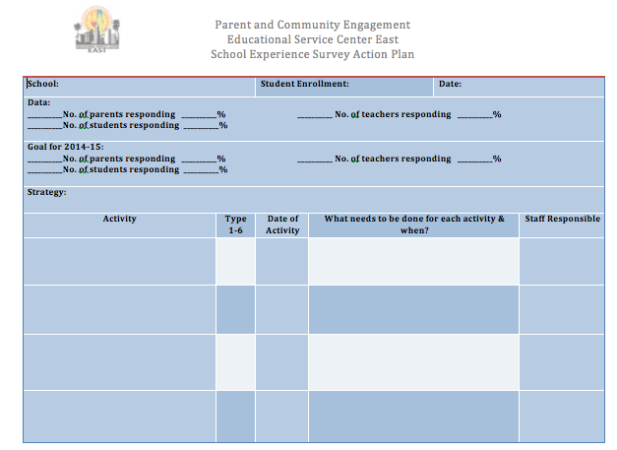
School Experience Survey Action Plan
Optional Resource
Notes:
This School Experience Survey (SES) Action Plan sheet can be used to plan for the upcoming SES.

Slide 36
THE KEYS TO SUCCESSFUL
SCHOOL-FAMILY-COMMUNITY PARTNERSHIPS
EPSTEIN’S SIX TYPES OF INVOLVEMENT
PARENTING: Assist families in understanding child and adolescent
development, and in setting home conditions that support children
as students at each age and grade level. Assist schools in
understanding families.
Type 1
COMMUNICATING: Communicate with families about school
programs and student progress through effective school-to-home
and home-to-school communications.
Type 2
VOLUNTEERING: Improve recruitment, training, work, and
schedules to involve families as volunteers and audiences at school
or in other locations to support students and school programs.
Type 3
LEARNING AT HOME: Involve families with their children in
learning activities at home, including homework, other curriculum-
related activities, and individual course and program decisions.
Type 4
DECISION MAKING: Include families as participants in school
decisions, governance, and advocacy through PTA/PTO, school
councils, committees, action teams, and other parent organizations.
Type 5
COLLABORATING WITH COMMUNITY: Coordinate resources
and services for students, families, and the school with businesses,
agencies, and other groups, and provide services to the community.
Type 6
Notes:
To refresh your memory, you have the handout for each of the keys. You also have and second handout with information that includes, Sample Practices, Challenges, Redefinitions, and
Expected Results for each type of Involvement. Take 3 min and 23 seconds to review the documents.

Slide 37
Type 7 (XO)
RELATIONSHIP BUILDING:
Establishing a welcoming school environment, holding
Celebration events and activities to establish positive
relationships among families, schools and community that
can serve as a “gateway” for strengthening partnerships.
Notes:
The work of Joyce Epstein has identified a seventh key – Relationship Building. The concept behind relationship building is simple.
Rather than blaming each other, teachers and parents come together, in a unique setting, as equal partners, to build trust and form a relationship where they can take the time to share dreams, expectations, experiences, and tools regarding the child’s academic success.
Once a relationship is formed, the partners are empowered, finding accountability with each other to make the necessary changes to insure that students experience academic and social success.

Slide 38
ESC East Parent and Community Engagement Staff Directory
(323) 224-3320
1. Name: Miguel Dueñas
  Position: Administrator
  email:miguel.duenas@lausd.net
2 Name: Fannie González
  Position: Parent Educator Coach
  email:fxv6839@lausd.net
3. Name: Rosalba González
  Position: Parent Educator Coach
  email:ruribe@lausd.net
4. Name: Jose Morales
  Position: Parent Educator Coach
  email:jlm8772@lausd.net

